Slide 1
Stress, Anxiety, and children
PS 174 William Sidney Mount School
May 8, 2019

Slide 2
Objectives
Stress
Morning Stress
Stress is a Part of Life
Types of Stress
Stress in Children
Symptoms of Stress
Frustration
Anxiety
Types of Anxiety
Symptoms
How Adults Can Help
Routine
Stress Management
Words of Wisdom

Slide 3
Definitions of Stress
Stress
State of mental or emotional strain or tension resulting from adverse or very demanding circumstances
Response to a threat in a situation
Mental, physical strain condition that occurs when a person must adjust or adapt to the environment

Slide 4
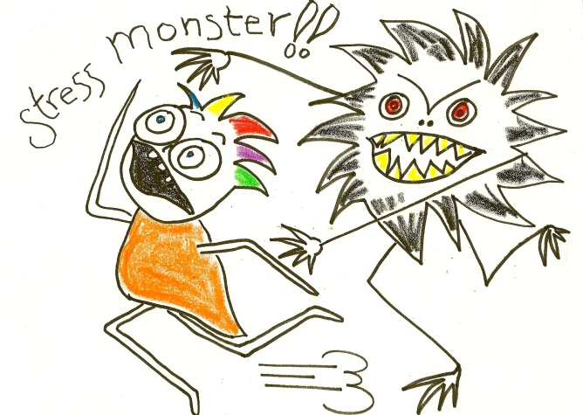
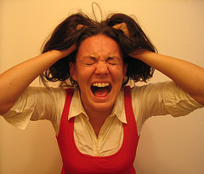
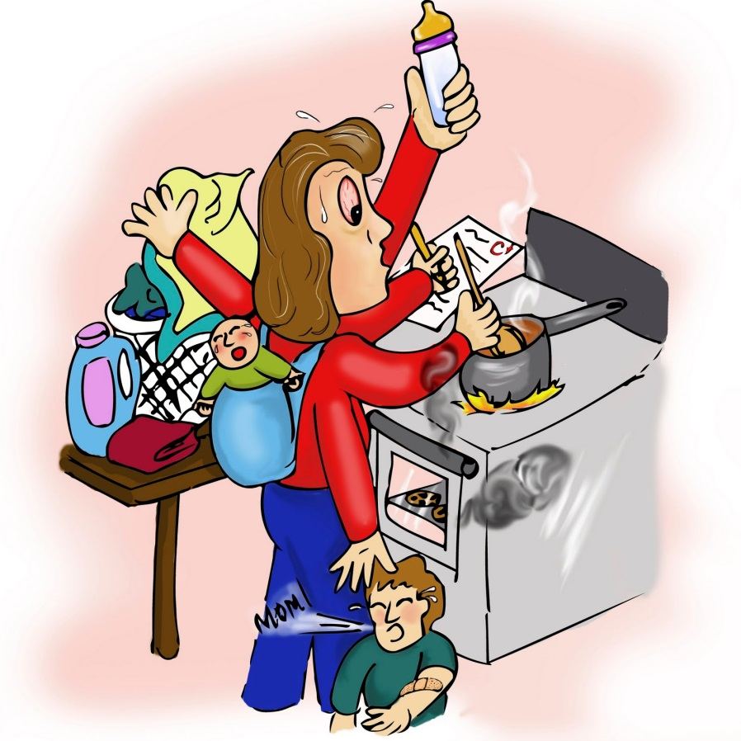

Slide 5
Morning Stress
It’s 8:00am. Your child have to be at school at 8:20. You’ve already gotten a warning that your child has been late too often. As you are getting your coat on, your child is taking their time. Their backpack is in their room, their shoes are in the hallway and under the couch, they are still wearing their pjs pants and they have not brushed their teeth. “C’mon now, hurry up or we’ll be late” you say, several times, but your child sits on the floor looking at your saying they are tired.
Just then a younger sibling comes up and hits them in the head with their backpack as they are walking by……..
Notes:
Meg

Slide 6
Morning Stress
Imagine yourselves in the scenario.
What physical sensations would you feel?
What are the first thoughts you would have?
What emotions are you feeling?
What actions do you want to take?
Notes:
Meg

Slide 7
My boys…..

Slide 8
Stress IS a Part of Life
Some Stress is just unavoidable.
Notes:
Meg

Slide 9
Stress is Real and it’s Here to Stay
Stress comes from a primitive part of our brain that tells us to be afraid. So, some fears are worthy and some are not.
Stress looks forward and backwards to the what if's and I should have's.
BF

Slide 10
Types of Stress
There are two types of stress:
Eustress (good, motivating)
Acute Stress- common form of stress, it is the everyday demands and future pressures. It can be exciting in small doses but exhausting. Events such as homework, school, weddings, presenting in front of people, etc.
Distress (bad, hard to cope with)
Chronic stress- This is the grinding stress that wears people away day after day, year after year. Chronic stress destroys bodies, minds and lives. It wreaks havoc through long-term attrition. It's the stress of poverty, of dysfunctional families, of being trapped in an unhappy marriage or in a despised job or career. It's the stress that the never-ending "troubles."
BF
Notes:
Acute stress is the most common form of stress. It comes from demands and pressures of the recent past and anticipated demands and pressures of the near future. Acute stress is thrilling and exciting in small doses, but too much is exhausting. A fast run down a challenging ski slope, for example, is exhilarating early in the day. That same ski run late in the day is taxing and wearing. Skiing beyond your limits can lead to falls and broken bones. By the same token, overdoing on short-term stress can lead to psychological distress, tension headaches, upset stomach and other symptoms.
Fortunately, acute stress symptoms are recognized by most people. It's a laundry list of what has gone awry in their lives: the auto accident that crumpled the car fender, the loss of an important contract, a deadline they're rushing to meet, their child's occasional problems at school and so on.
Because it is short term, acute stress doesn't have enough time to do the extensive damage associated with long-term stress. The most common symptoms are:
Emotional distress — some combination of anger or irritability
, anxiety and depression, the three stress emotions.
Muscular problems including tension headache, back pain, jaw pain and the muscular tensions that lead to pulled muscles and tendon and ligament problems.
Stomach, gut and bowel problems such as heartburn, acid stomach, flatulence, diarrhea, constipation and irritable bowel syndrome.
Transient overarousal leads to elevation in blood pressure, rapid heartbeat, sweaty palms, heart palpitations, dizziness, migraine headaches, cold hands or feet, shortness of breath and chest pain.
Acute stress can crop up in anyone's life, and it is highly treatable and manageable.

Slide 11
Stress in children
Discussion: What causes stress in children?
To think about: What causes stress in your own children?
Notes:
Discussion points:
-What is stressful to some might be more stressful or less stressful to others
-Think of your kids: what is the most stressful for them?

Slide 12
Stress in Children
Lots of pressures on kids today
The majority of stress stems from external situations (difference between children and adults)
Associated with frustration and nervousness
What is stressful to one child might not be stressful to another
Notes:
Emily

Slide 13
Biggest stressors in children
Big Changes in Family
Parental Instability
Overly Packed Schedules
Academic Pressure
Catastrophic Event in the News
Conflicts in School/ Friends
Popularity (fitting in)
Bullying
Fear of Missing Out
Physical Stressors (weight, appearance, etc)
Notes:
Pain, injury, illness, and other changes are stressors for children. Stressors may include:
Worrying about schoolwork or grades
Juggling responsibilities, such as school and work or sports
Problems with friends, bullying, or peer group pressures
Changing schools, moving, or dealing with housing problems or homelessness
Having negative thoughts about themselves
Going through body changes, in both boys and girls
Seeing parents go through a divorce or separation
Money problems in the family
Living in an unsafe home or neighborhood

Slide 14
Symptoms of Stress
Physical symptoms can include:
Decreased appetite, other changes in eating habits
Headache
New or recurrent bedwetting
Nightmares
Sleep disturbances
Upset stomach or vague stomach pain
Other physical symptoms with no physical illness
Emotional or behavioral symptoms may include:
Anxiety, worry
Not able to relax
New or recurring fears (fear of the dark, fear of being alone, fear of strangers)
Clinging, unwilling to let you out of sight
Anger, crying, whining
Not able to control emotions
Aggressive or stubborn behavior
Going back to behaviors present at a younger age
Doesn't want to participate in family or school activities

Slide 15
The big feeling with children: Frustration
Negative emotional state that occurs when one is prevented from reaching desired goals
It can be external frustration or internal frustration
The feeling of “AAARRRRRGGGH!”
A good emotion because when we get frustrated, we are motivated to remove the obstacle that is blocking our path toward our goals.

Slide 16
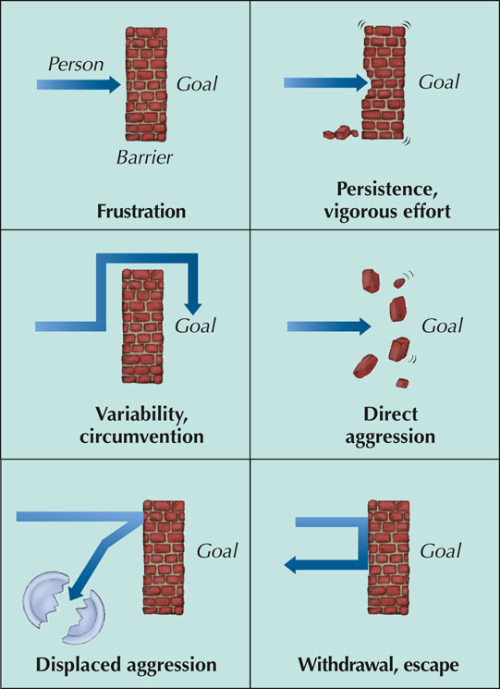
Reactions to Frustrations
Fig. 13-4, p. 436
Notes:
Figure 13.4

Slide 17
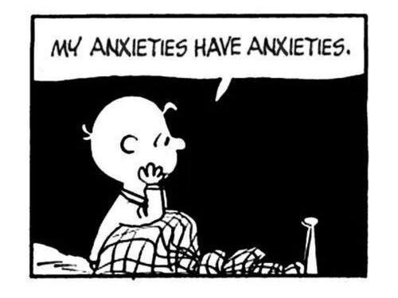
Anxiety and Stress: The Difference
“With stress, we know what’s worrying us, but with anxiety you become less aware of what you’re anxious about [in the moment] and the reaction comes the problem. You start to feel anxious about being anxious”
Comes from a place of fear, unease, and worry

Slide 18
Anxiety
A state of apprehension or worry about a danger or threat that might occur
Brain based-fight/flight system is activated
Sense of helplessness
Most common mental health problem of childhood and adolescence
More girls than boys
Notes:
Kay

Slide 19
Why it happens
Environmental – witnessing a traumatic event/having a traumatic experience/watching another child be scared
During life changes/transitions-death in the family, illness, recent move, new school, birth of sibling, etc.
Biological-genetic predisposition- studies have shown children are more likely to develop an anxiety disorder if their parents have anxiety disorders
Notes:
Kay

Slide 20
Anxiety Disorders That Affect Children
Anxiety Disorder | Symptoms
Separation Anxiety Disorder | These kids not only won't spend the night with a friend or family member without their parents, they want someone with them until they fall asleep; difficulty staying long periods of time with familiar adults such as : Family members or a babysitter. The level of anxiety is inappropriate for their age.
Social Anxiety Disorder | A strong fear of social situations, being the focus of attention and/or being around unfamiliar people. afraid to talk in class, meet new people or even walk through a crowded room. It is far beyond just being shy.
Notes:
There are several anxiety disorders that affect children such as Generalized Anxiety Disorder (GAD) ; Separation Anxiety Disorder; Phobias ; Obsessive Compulsive Disorder ( ODD) ; Panic Disorder, Social Anxiety Disorder or Selective Mutism. Today, we will just take a look at the two most common: Separation Anxiety Disorder and Social Anxiety Disorder.
Separation anxiety disorder: These kids not only won't stay over somewhere without their parents, they want someone with them until they fall asleep, and can't even handle afternoons with a babysitter, friend or family member without great distress. (Excessive worry of being away from home or separated from parents that is inappropriate for the child's age.)
Social anxiety disorder or social phobia: A strong fear of social situations, being the focus of attention and/or being around unfamiliar people. Kids with this are afraid to talk in class, meet new people or even walk through a crowded room. It is far beyond just being shy.

Slide 21
Signs and Symptoms
Disinterest in favorite extracurricular activities
Problems at school and losing interest in school
Substance abuse, including alcohol and drug (illegal and legal drugs) use
Behavioral problems
Withdrawing from family and friends
Sleep changes
Changes in eating habits
Begins to neglect hygiene and other matters of personal appearance
Emotional distress brings on physical complaints (aches, fatigues, migraines)
Hard time concentrating and paying attention
Declining grades in school
Loss of interest in schoolwork
Risk taking behaviors
Complains more frequently of boredom
Does not respond as before to praise
Changing friend groups
Isolating from friends and family
SS

Slide 22
Stress versus Anxiety versus anxiety disorder
Consistent, Chronic
Anxiety
Normal everyday
Stress
Excessive, Completely Preoccupied
Anxiety Disorder
PLEASE DO NO SELF DIAGNOSIS. PLEASE SEEK ASSISTANCE!

Slide 23
HOW CAN THE ADULTS HELP?

Slide 24
It’s all about Routine
When children don’t know what to expect OR if too much of their day is filled with un-structured activities, it can cause feelings of anxiety and resistance.
Children feel a sense of ‘safety’ when they know what to expect at various points during their day.
Getting used to a particular routine means they know what to expect and could lead to less resistance when it’s time to start their day.
Notes:
Lisa Discussion question for group: What are some routines in your family that you already use that help prevent stress?

Slide 25
Stress Management Tools
Sleep
Eat right
Avoid caffeine
Exercise
Music
Relaxation techniques
Prayer/spirituality
Set priorities
Study smarter, not harder
Planning/organization
Compartmentalizing
BF

Slide 26
How To Talk to Your Children About Anxiety
Talk privately and tell them you notice something is bothering him/her
Listen attentively/calmly to what is wrong
Validate feelings & label them if appropriate
Involve the child in the solution – help them brainstorm things that might help
Be patient – just being there helps
Notes:
Emily

Slide 27
Words of Wisdom
Validation
I hear you saying you feel really sad.
That sounds very painful.
Ask open-ended questions
Have you ever felt really frustrated?
How long have you felt that way?
Has this happened before? How long did it last?
Be in contact with your child’s therapist and psychiatrist
Get therapy for yourself
Sending only the kid gives them the message: “I am broken, and they want this therapist to fix me.”
It is hard to watch your kids struggle!
SS

Slide 28
Food for thought…
Where do we think that children learn to manage/ handle stress from?
QUESTIONS? THANK YOU!
Notes:
Emily
Activity – turn to your table and each take turns letting each other know one way you handle your stress that you’d like to get away from, one one way you handle stress that you’d like to do more of

